Slide 1
Linda McPherson McPherson’s Music Room

Slide 2
Linda McPherson McPherson’s Music Room

Slide 3
Linda McPherson McPherson’s Music Room

Slide 4
Linda McPherson McPherson’s Music Room

Slide 5
Linda McPherson McPherson’s Music Room

Slide 6
Linda McPherson McPherson’s Music Room

Slide 7
Linda McPherson McPherson’s Music Room

Slide 8
Linda McPherson McPherson’s Music Room

Slide 9
Linda McPherson McPherson’s Music Room

Slide 10
Linda McPherson McPherson’s Music Room

Slide 11
Linda McPherson McPherson’s Music Room

Slide 12
Linda McPherson McPherson’s Music Room

Slide 13
Linda McPherson McPherson’s Music Room

Slide 14
Linda McPherson McPherson’s Music Room

Slide 15
Linda McPherson McPherson’s Music Room

Slide 16
Linda McPherson McPherson’s Music Room

Slide 17
Linda McPherson McPherson’s Music Room

Slide 18
Linda McPherson McPherson’s Music Room

Slide 19
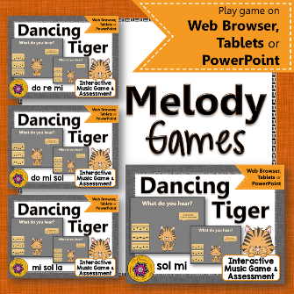
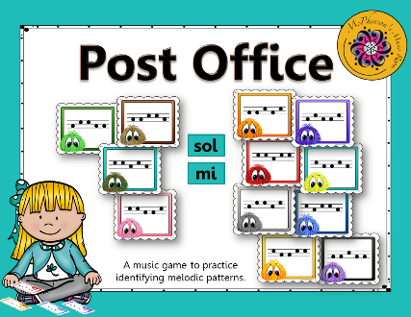
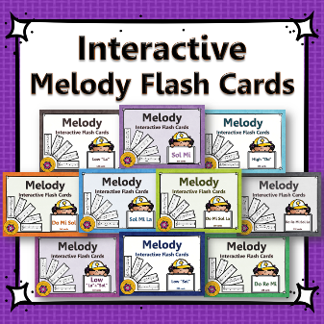
Linda McPherson McPherson’s Music Room

Slide 20
Linda McPherson McPherson’s Music Room

Slide 21
Owls licensed by Alice Smith
sold by Dollar Graphics Depot
Black frames licensed by Dancing Crayons Designs
and Anastasiya Multimedia Studio
Colored frame Steach4fun
Font licensed by Kimberly Geswein Fonts
Sound Effects licensed by Finnolia Productions Inc, SFX Source.com
Audio Sparks and provided by Mike Koenig at SoundBible.com
Linda McPherson McPherson’s Music Room

